Slide 1
Spring Introduction
Computación en Internet II
2023-2

Slide 2
Frameworks often implement design patterns and principles to help you write better code.
Design Principle: Provide high level guidelines to design better software applications. They do not provide implementation guidelines and are not bound to any programming language. The SOLID (SRP, OCP, LSP, ISP, DIP) principles are one of the most popular sets of design principles.
Design Pattern: Provides low-level solutions related to implementation, of commonly occurring object-oriented problems. In other words, design pattern suggests a specific implementation for the specific object-oriented programming problem. Ex: Singleton, factory, Command, Observer, etc.

Slide 3
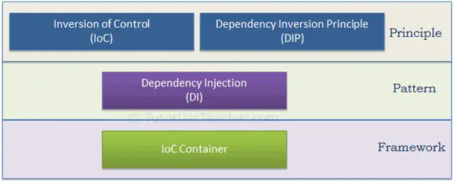

Slide 4
Frameworks often implement design patterns and principles such as:
Model-View-Controller (MVC) Framework, which separates the application logic into three components with single responsibilities.
Dependency Injection (DI) Framework allows you to inject dependencies into your classes or modules instead of creating them inside, reducing coupling and increasing cohesion.
Test-Driven Development (TDD) Framework encourages writing tests before code to help follow the SRP and refactor the code for greater cohesion and less coupling.

Slide 5

What is Spring?
The spring framework provides a programming and configuration mode for java-based enterprise applications.
Spring focuses on the “plumbing” of enterprise applications so that teams can focus on application-level business logic.

Slide 6
What is Spring?
A container:
Create objects and makes them available to your application
Uses a declarative XML structure to define components that “live” in the container
A Framework:
Provides an infrastructure of classes that make it easier to accomplish tasks
For example, Templates provides an abstraction away from details of dataAccess, remote calling.

Slide 7
What is Spring?
Spring is a lightweight framework that addresses each tier in a Web application
Presentation Layer: An MVC framework that is most similar to Struts but is more powerful and easier to use.
Business layer: Lightweight IoC container and AOP support
Persistence layer: DAO template support for popular ORMs and JDBC

Slide 8
Inversion of Control
The basic concept of the inversion of Control principle is that programmers don’t need to create their objects but instead, they need to describe how they should be created through rules defined in e.g. factory classes and/or , configuration files.
Subsequently, your application code does not directly connect your implementation components together but instead uses abstractions such as interfaces that represent them. Spring provides the actual implementations.

Slide 9
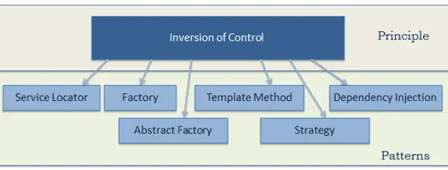
The following pattern (but not limited) implements the IoC principle.

Slide 10
Dependency Injection
Dependency injection us a pattern used to create instances of objects that have delegation patterns to other objects. However, at compile time the “calling class” has no knowledge of the dependency class implementation it will delegate to at Runtime. Because our Delegator Class code is coded to the interface abstraction of the delegating class.
With Spring, the implementation of dependency injection can be achieved via setter and/or constructor injection techniques.

Slide 11
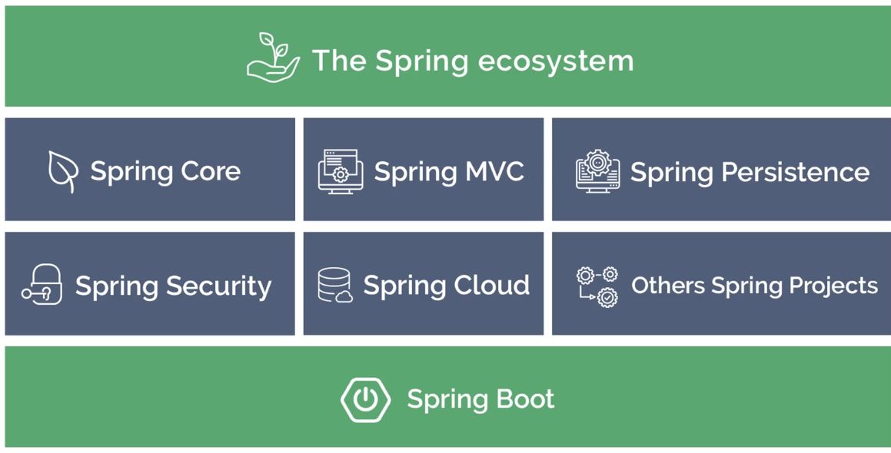

Slide 12
Core Modules
The Spring framework comprises of many modules such as cores, beans, context, expression languages, AOP, ASpects, Instrumentation, JDBC, ORM, OXM, JMS, Transaction, Web, Servlet, Struts etc.
The Spring core container contains core, beans, context and expression language (EL) Modules

Slide 13
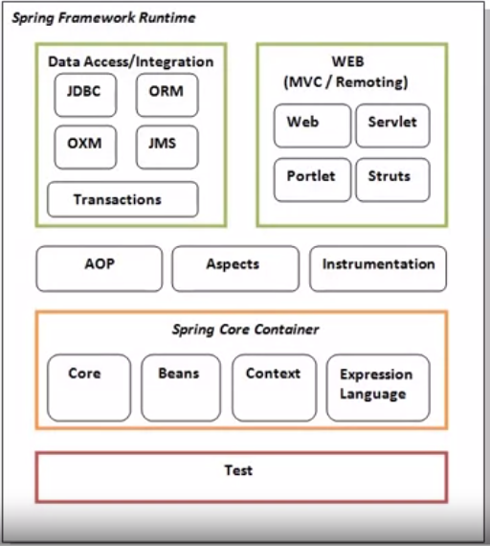
Core Modules
These modules are grouped into:
Test
Core Container
Aspect Oriented Programming
Aspects
Instrumentation
Data Access / Integration
Web (MVC / Remoting)

Slide 14
Core Modules
Core and Beans; these modules provide IOC and Dependency injection features
Context; This module supports internationalization (I18N), EJB, JMS.
Expression Language; It is an extension to the EL defined in JSP. It provides support to setting and getting property values and even method invocation
AOP, Aspects and Instrumentation; These modules support aspect oriented programming implementation where you can use Advices, Pointcuts
The aspects module provides support to integration with AspectJ
Data Access / Integration; These modules basically provide support to interact with the database
Web; This group provide support to create web applications

Slide 15
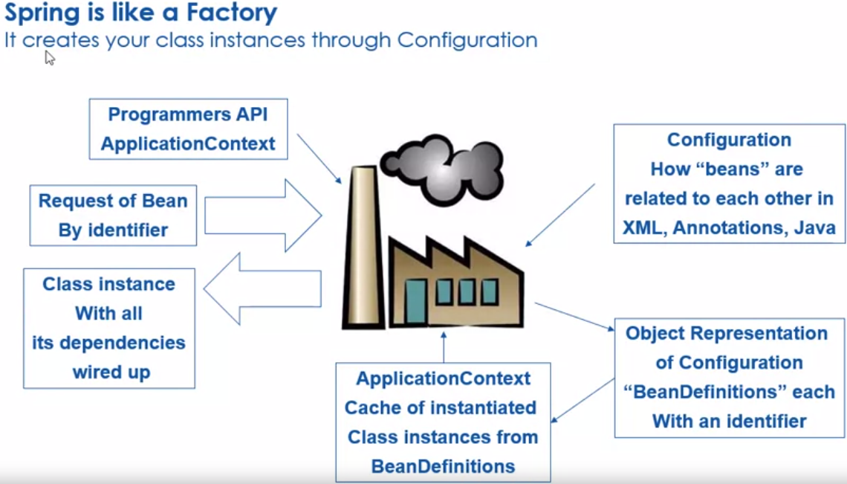

Slide 16
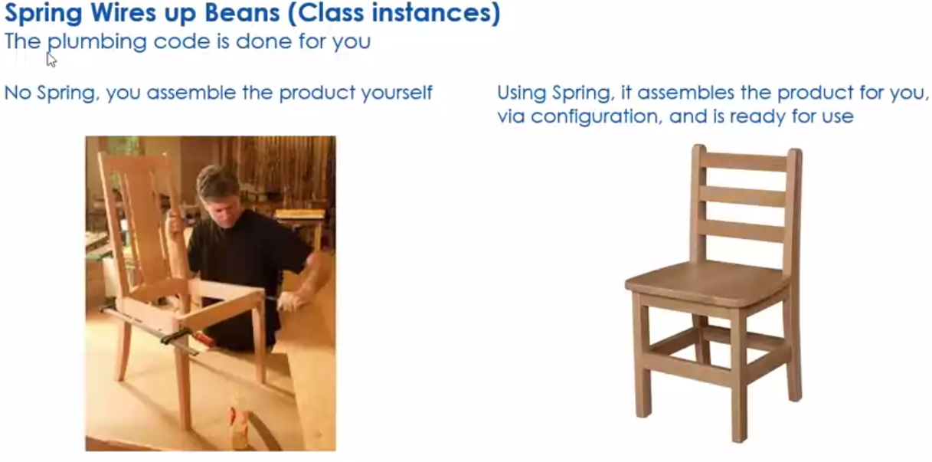

Slide 17
Discussion: Spring and Plumbing
Explain what is meant by "Spring wires up the plumbing code".
Why do you think this is an important aspect of Spring?
Would this appeal to many developers?

Slide 18
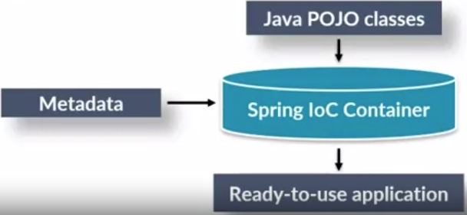
Spring IoC Containers
The Spring Containers forms the core of the Spring Framework
The container instantiates, configures, and assembles the dependencies between the objects.
The IoC container construct an object of the selected class
And also inject the dependency objects via a constructor, a property or a function at execution time and disposes it at suitable time.

Slide 19
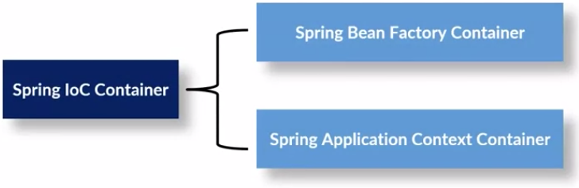
The Spring Container
Spring containers are simple java classes and interfaces.
There are many spring containers among which two are very important.

Slide 20

Bean factories defined by the org.springframework.beans.factory.BeanFactory interface are the simplest of containers, providing basic support for dependency injection (DI). This BeanFactory is the super interface of all the spring containers.
Application contexts defined by the org.springframework.context.ApplicationContext interface build on the notion of a bean factory by providing application framework services.

Slide 21
The Spring Container
These BeanFactory and ApplicationContext are java interfaces, but in spring world these are called as containers.
BeanFactory is an implementation of the Factory design pattern. As the name says it is a factory of Beans whose responsibility is to create and dispense beans.
ApplicationContext interface extends the BeanFactory interface. To take full advantage of Spring framework most of the time we load beans using more advanced spring container ApplicationContext.

Slide 22
Spring Bean
Spring beans are the objects which are created and managed completely by spring container.
These beans are the heart of the application
Beans can be defined in spring either by using XML configuration or by using Annotation.
In XML configuration, bean can be defined using <bean> tag inside <beans> tag.
In Annotation configuration, bean can be defined using the annotations,
Like @Component, @Service, @Controller and @Repository on top of the class definition.
We can also achieve beans definition completely in java using java configuration.

Slide 23
Spring Bean Scope
Scope of a bean specifies what kind of object has to be created by container for bean defined.
We can define the scope of the bean while defining the bean in the spring configuration file
We can also customize and create custom scope.
Types of bean scopes supported by Spring are as follows
Singleton
Prototype
Request
Session
Application

Slide 24
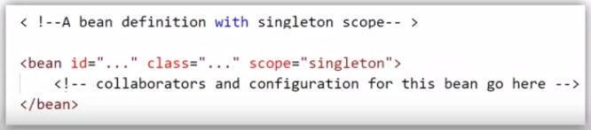
Singleton scope
Singleton bean will be only one instance for entire spring container,
no matter how many times and in how many places we access it using context.getBean() method.
This single instance is stored in a cache of such singleton beans,
and all subsequent requests and references for that named bean return the cached object.
If we didn’t add any scope for the bean, then Spring automatically makes that bean as Singleton.

Slide 25
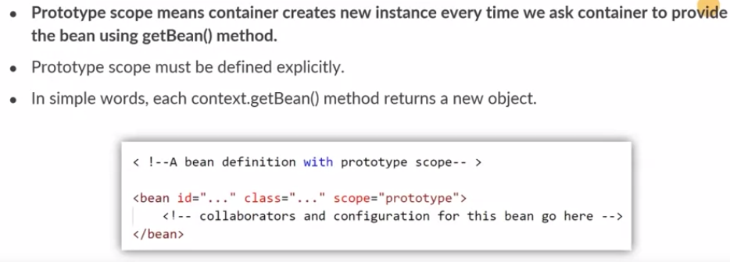
Prototype scope

Slide 26
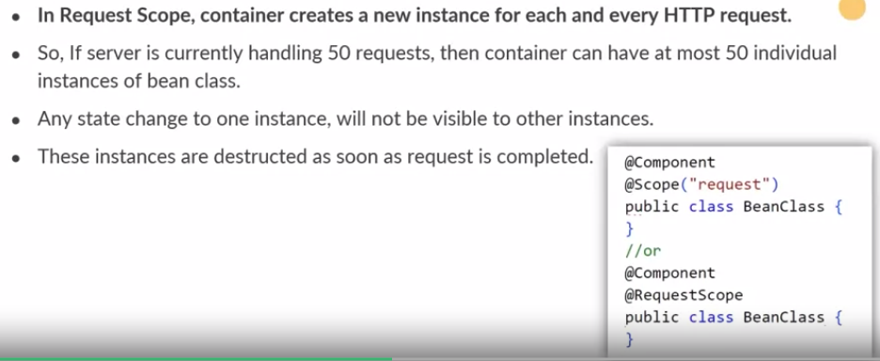
Request scope

Slide 27
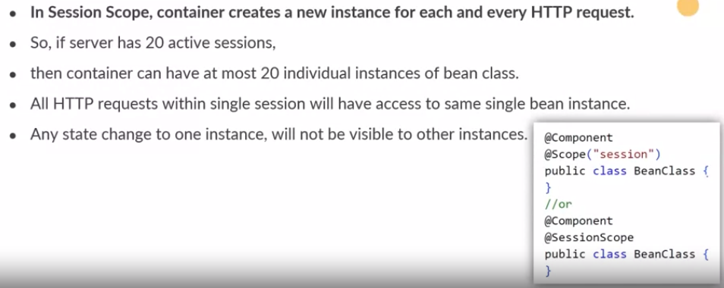
Session scope

Slide 28
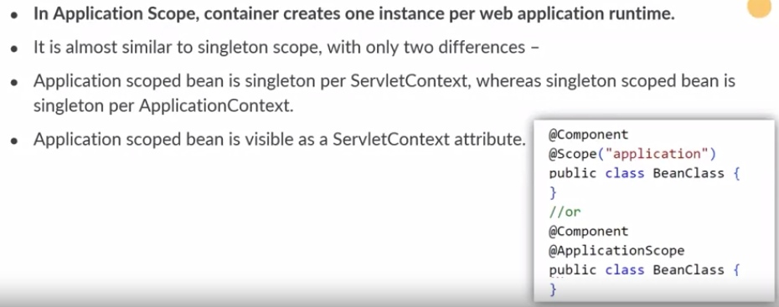
Application scope

Slide 29
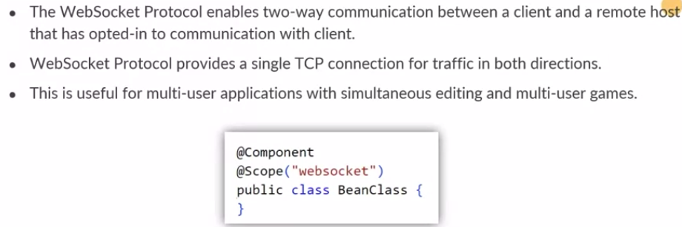
WebSocket scope

Slide 30
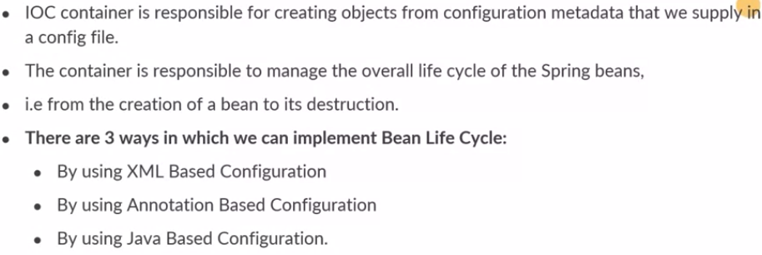
Spring Bean Lifecycle

Slide 31
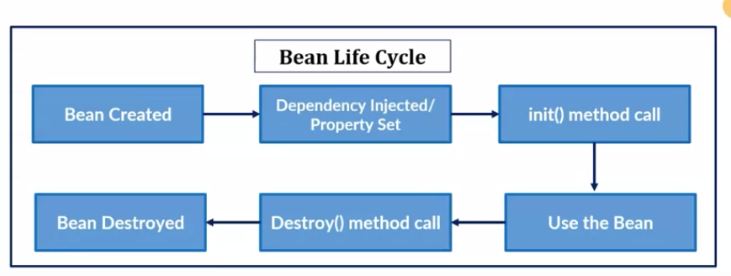
Bean Life Cycle

Slide 32
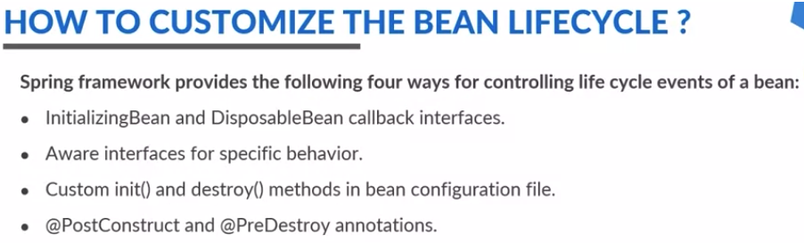

Slide 33
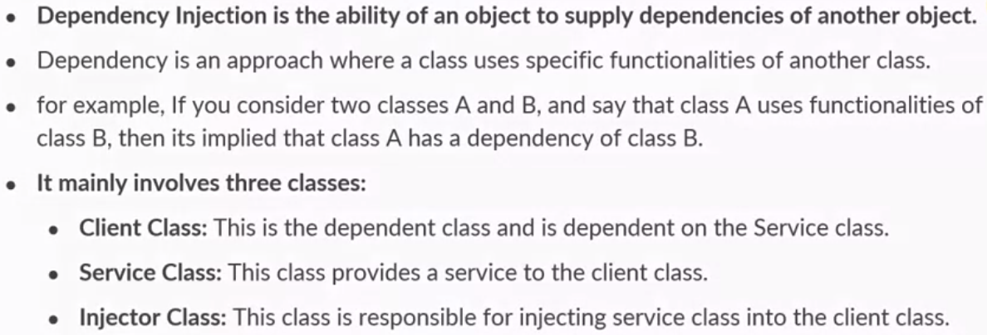
Dependency Injection

Slide 34
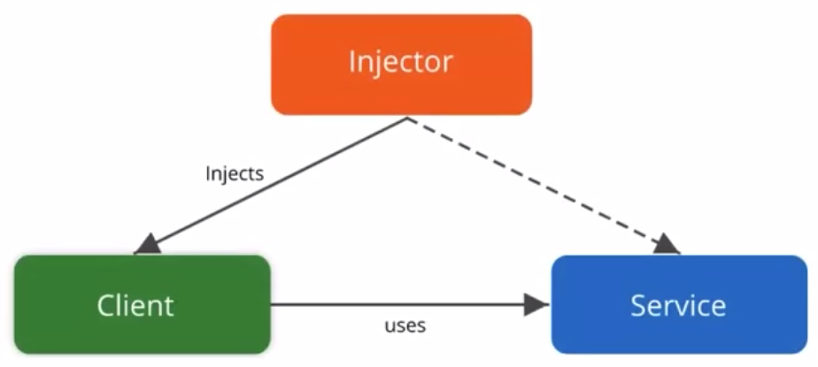
Dependency Injection

Slide 35
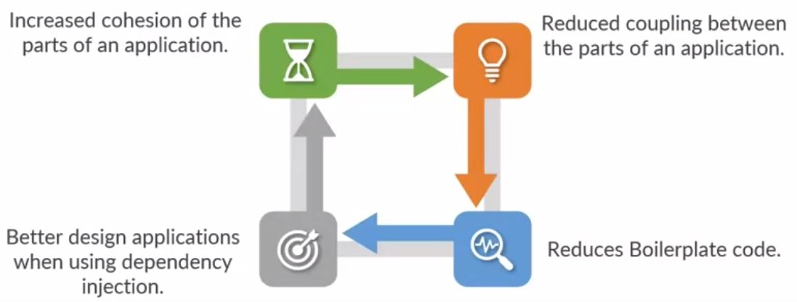
Benefits of Dependency Injection

Slide 36
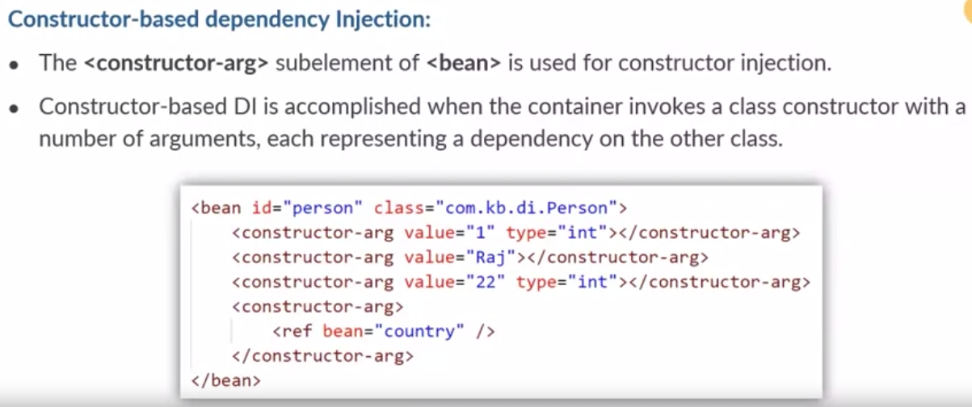
Types of Dependency Injection

Slide 37
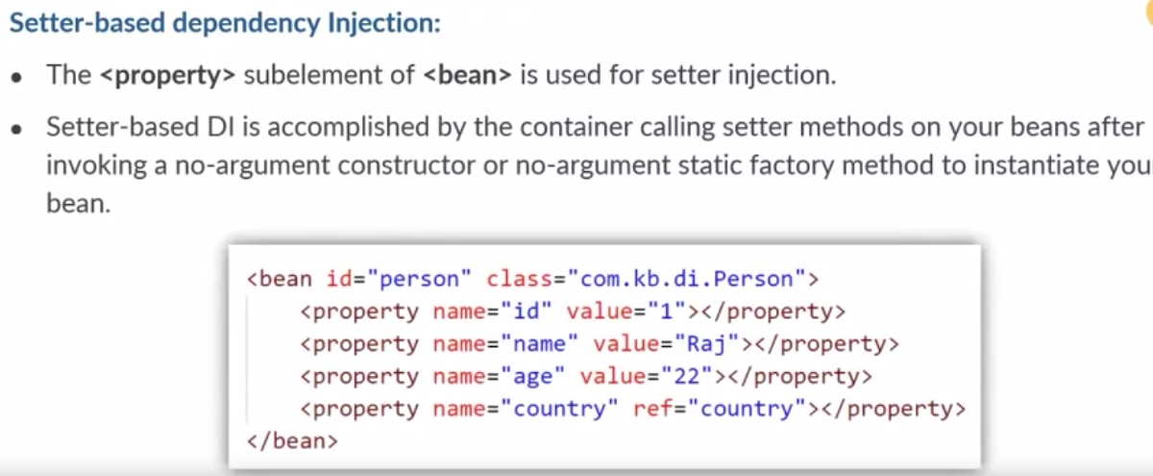
Types of Dependency Injection

Slide 38
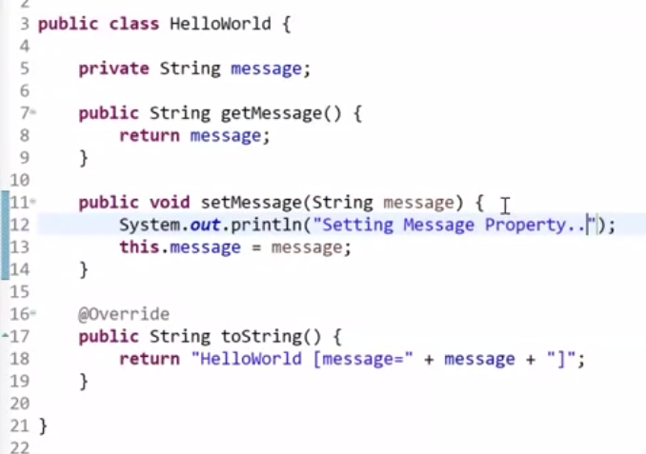
La clase con el método
Setter, pero sin el
Método
constructor.

Slide 39
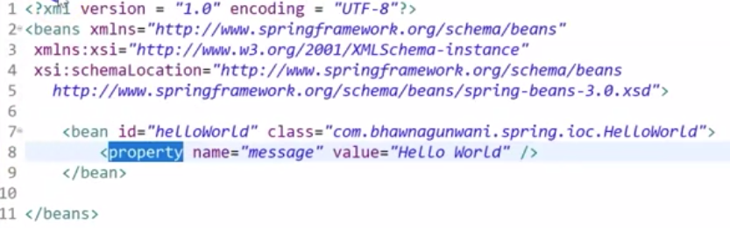
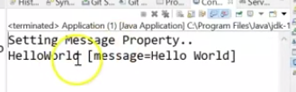
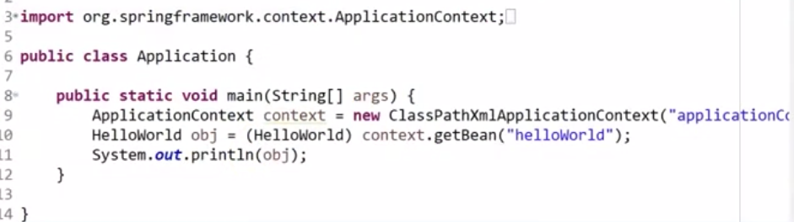

Slide 40
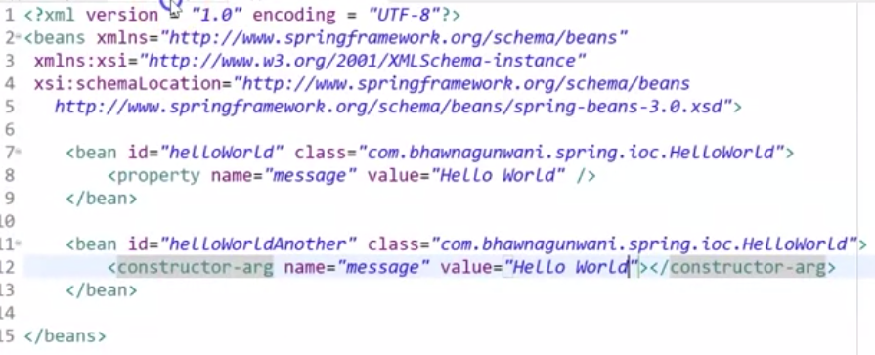
Para injectar en el constructor se adiciona el bean constructor-tag

Slide 41
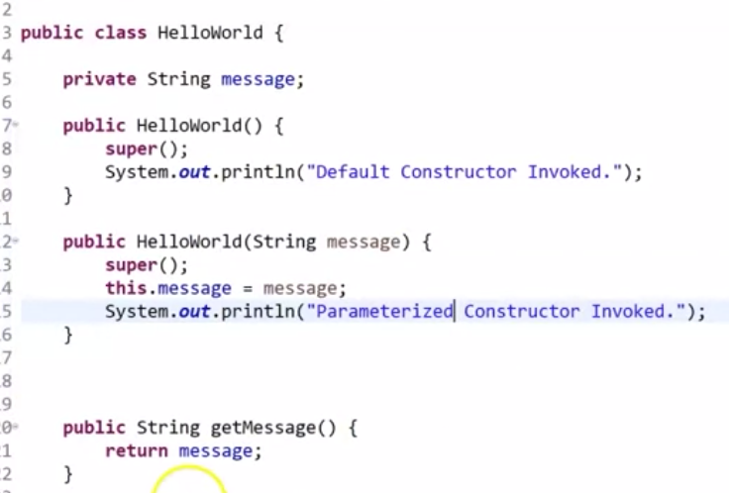
La clase puede tiene dos constructores: por defecto y parametrizado

Slide 42
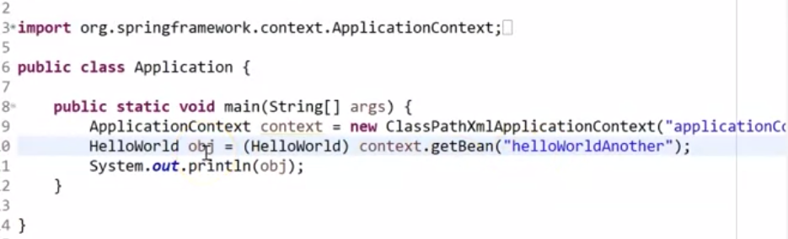
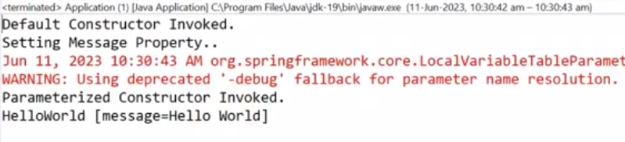

Slide 43
Further Reading on spring
Spring Modules: https://www.javatpoint.com/spring-modules
Sprint Application: https://www.baeldung.com/spring-boot-start
IOC Container y Dependency Injection:
https://www.baeldung.com/inversion-control-and-dependency-injection-in-spring
A simple tutorial for Setter Injection using XML: https://www.baeldung.com/spring-xml-injection
Should I use Setter injection or Constructor Injection? https://spring.io/blog/2007/07/11/setter-injection-versus-constructor-injection-and-the-use-of-required

Slide 44
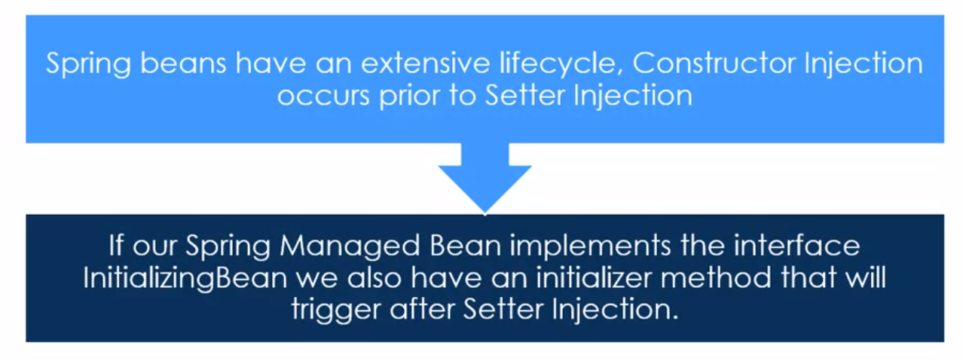
Annotations

Slide 45
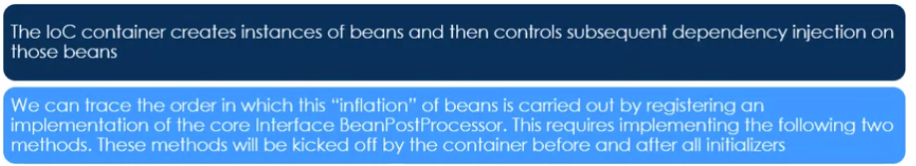
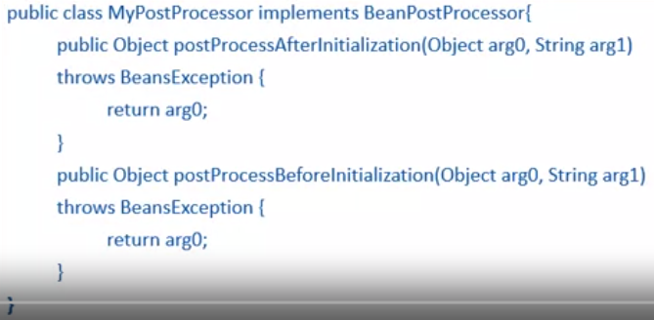

Slide 47
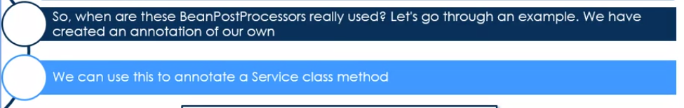
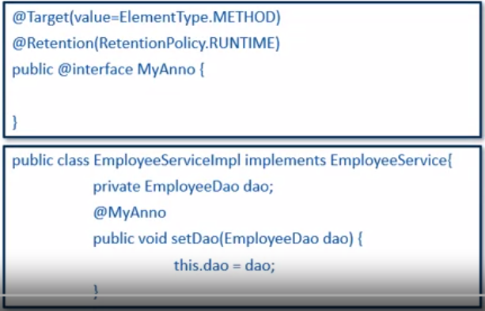
Custom Annotations

Slide 48
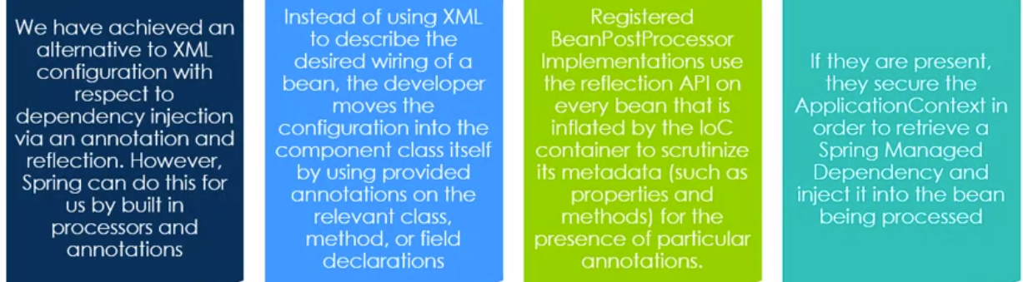
Using Annotations

Slide 49
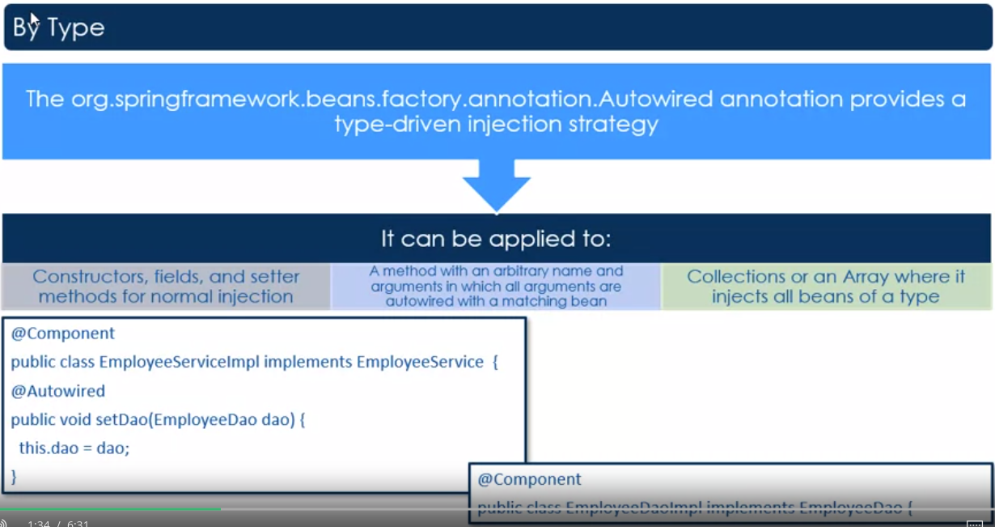
@Autowired

Slide 50
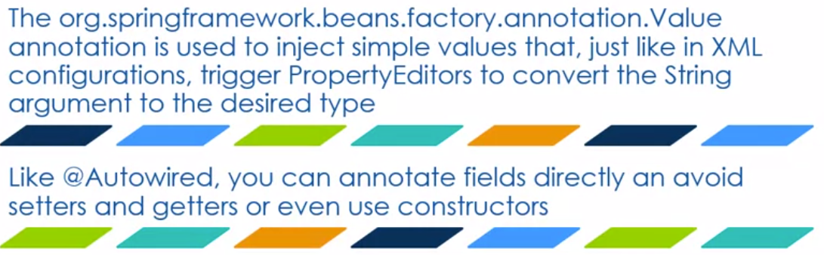
Simple Value Injection

Slide 51
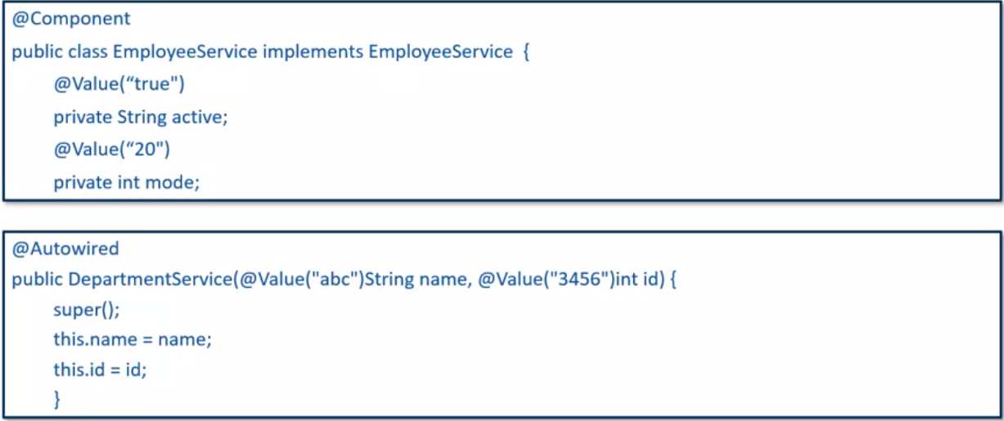
@Value

Slide 52
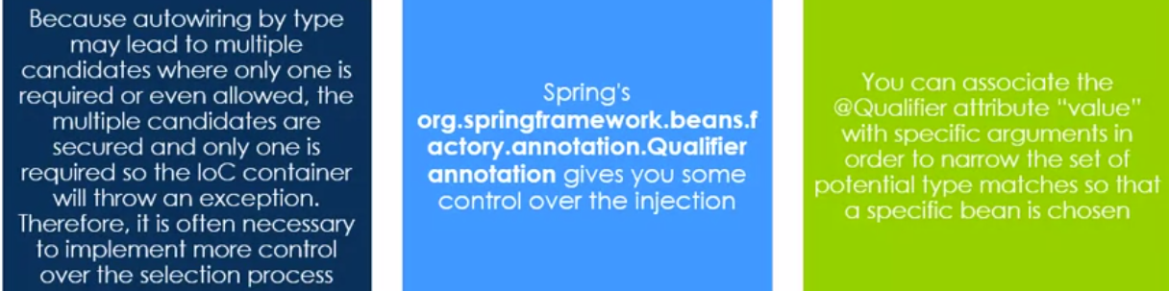
Using @Qualifier

Slide 53
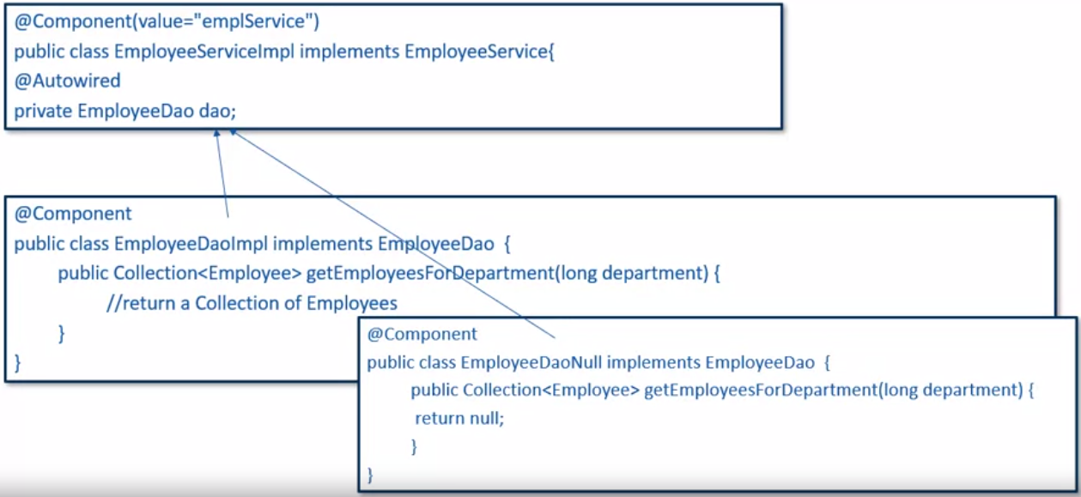
The need for Qualification

Slide 54
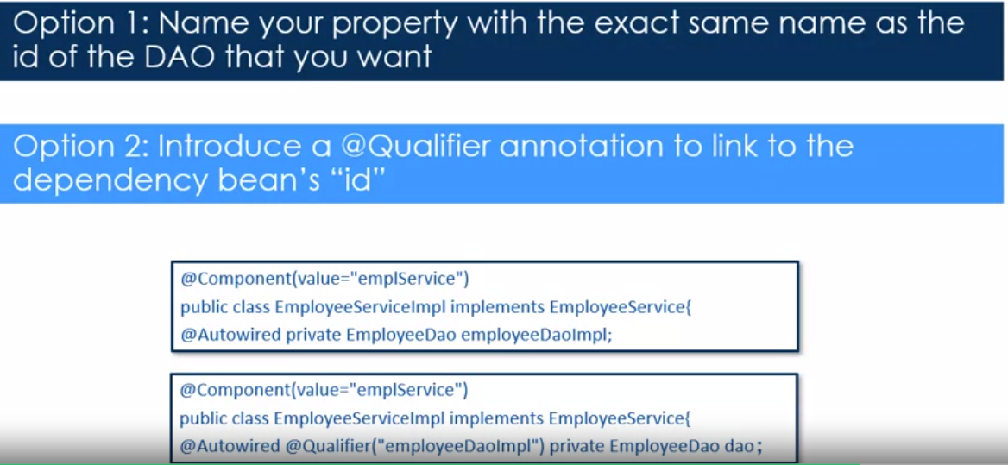
Qualification

Slide 55
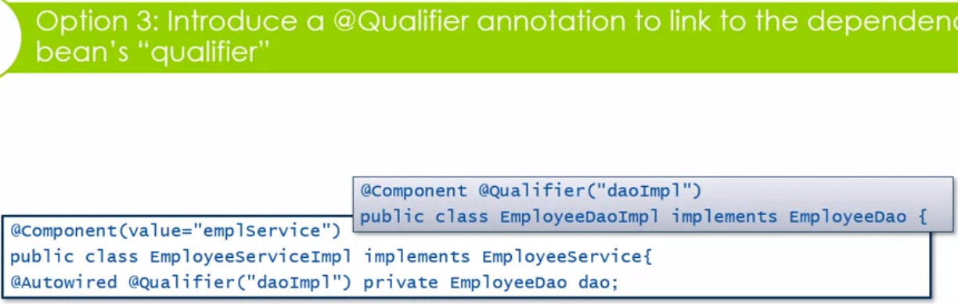
Qualification

Slide 56
Annotations
Spring Core Annotations:
https://www.baeldung.com/spring-core-annotations
How easy is Java Configuration in a Spring application? https://www.codejava.net/frameworks/spring/spring-dependency-injection-example-with-java-config

Slide 57
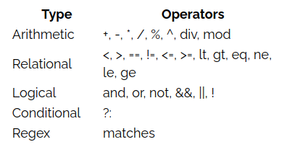
Spring Expression Language (SPEL)
The Spring expression language will allow us to inject properties into the Beans at runtime, both for XML and Java, automatically or programmatically.
There are several operators available in the language:

Slide 58
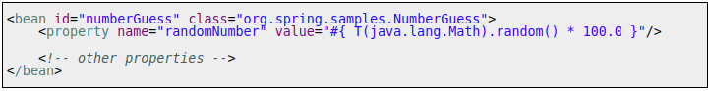
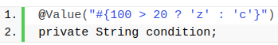
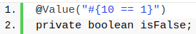
Spring Expression Language (SPEL)
SpEL expressions begin with the # symbol and are wrapped in braces: #{expression}.
Properties can be referenced in a similar fashion, starting with a $ symbol and wrapped in braces: ${property.name}.

Slide 59
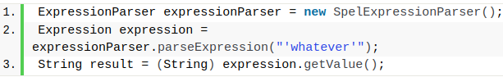
Spring Expression Language (SPEL)
Thanks to all the automatic configurations that Spring gives us, the most common way to use SpEL is usually automatically(XML or Annotations).
But for those cases in which we need to do it programmatically, we can also make use of SpEL SpelExpressionParser.
The following code introduces the SpEL API to evaluate the expression “whatever”

Slide 60
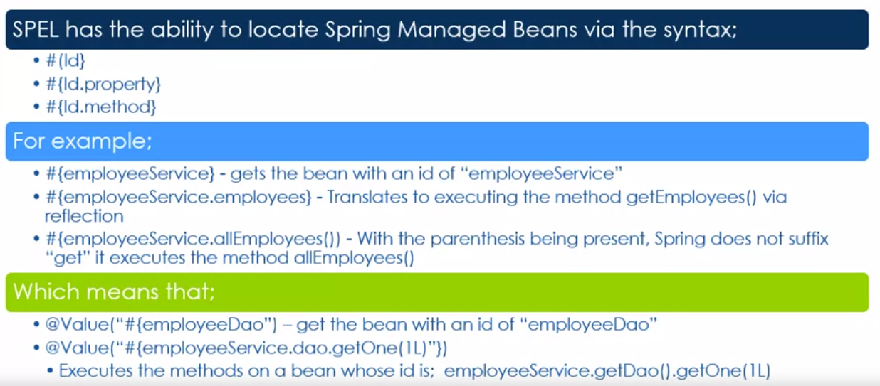
Spring Expression Language (SPEL)

Slide 61
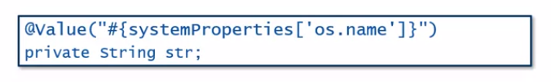
Spring Expression Language (SPEL)
SPEL has the variable systemProperties predefined, so you can use it in your expressions to access System properties.

Slide 62

Spring Expression Language (SPEL)

Slide 63

Spring Expression Language (SPEL)

Slide 64

Spring Expression Language (SPEL)

Slide 65


Spring Expression Language (SPEL)
With the help of SpEL, we can access the contents of any Map or List in the context. We'll create new bean workersHolder that will store information about some workers and their salaries in a List and a Map:

Slide 66
Reading for Expression Language
Using expressions in @Value to make your configurations more dynamic
https://stackabuse.com/the-value-annotation-in-spring/
See the power of Spring Expression Language (SPEL)
https://www.baeldung.com/spring-expression-language
Why do we use Conditionals in our Spring application development?
https://reflectoring.io/spring-boot-conditionals/
https://sodocumentation.net/spring/topic/4732/conditional-bean-registration-in-spring

Slide 67
Aspect Oriented Programming
AOP is a programming paradigm that aims to increase modularity by allowing the separation of cross-cutting concerns. It does this by adding additional behavior to existing code without modifying the code itself.
In object-oriented languages, the system structure is based on the idea of classes and class hierarchies. Inheritance allows you to modularize the system, eliminating the need to duplicate code.
However, there are always aspects that are transversal to this structure: the most classic example is the control of execution permissions of certain methods in a class.

Slide 68

Aspect Oriented Programming
In AOP, the elements that are transversal to the structure of the system and can be modularized thanks to the constructions provided by the paradigm are called aspects. In the example, execution permission control, modularized through AOP, would be one aspect.

Slide 69
Aspect Oriented Programming
Aspect-oriented Programming (AOP) complements Object-oriented Programming (OOP) by providing another way of thinking about program structure.
The key unit of modularity in OOP is the class, whereas in AOP the unit of modularity is the aspect.
Aspects enable the modularization of concerns (such as transaction management) that cut across multiple types and objects. (Such concerns are often termed "crosscutting" concerns in AOP literature.)
One of the key components of Spring is the AOP framework. While the Spring IoC container does not depend on AOP (meaning you do not need to use AOP if you don’t want to), AOP complements Spring IoC to provide a very capable middleware solution.

Slide 70

AOP Concepts and Terminology
Business Object
A business object is a normal class that has a normal business logic. Let's look at a simple example of a business object where we just add two numbers:
Note that this class is a normal class with business logic, without any Spring-related annotations.

Slide 71

AOP Concepts and Terminology
Aspect
An aspect is a modularization of a concern that cuts across multiple classes. Unified logging can be an example of such cross-cutting concern.
Let's see how we define a simple Aspect:
next, we'll see how we can wire this Aspect to our Business Object.

Slide 72
AOP Concepts and Terminology
Joinpoint
A Joinpoint is a point during the execution of a program, such as the execution of a method or the handling of an exception.
In Spring AOP, a JoinPoint always represents a method execution.
Pointcut
A Pointcut is a predicate that helps match an Advice to be applied by an Aspect at a particular JoinPoint.
We often associate the Advice with a Pointcut expression, and it runs at any Joinpoint matched by the Pointcut.

Slide 73

AOP Concepts and Terminology
Advice
An Advice is an action taken by an aspect at a particular Joinpoint. Different types of advice include “around,” “before,” and “after.”
In Spring, an Advice is modelled as an interceptor, maintaining a chain of interceptors around the Joinpoint.

Slide 74
Reference
https://docs.spring.io/spring-framework/reference/
https://docs.spring.io/spring-framework/reference/core/beans/introduction.html
https://www.baeldung.com/inversion-control-and-dependency-injection-in-spring

